Slide 1
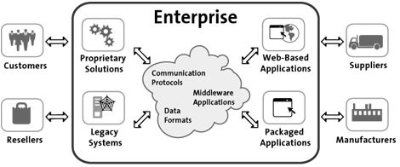
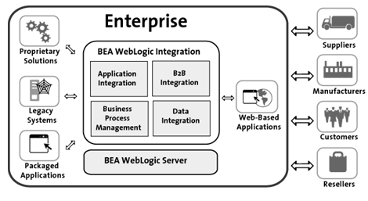

Slide 2
What Is Enterprise App Development?
Enterprise app development is the process of developing scalable apps that help companies facilitate their business processes. For example, an enterprise app helps to:
Keep company data updated across systems;
Align company divisions towards common goals;
Reduce handoff expenses between departments;
Help management to make data-informed decisions;
Have a centralized place to manage company processes.

Slide 3
Enterprise - Definition
An Enterprise is a complex , Socio-technical and distributed system.
An Enterprise comprises independent resources of People, Information, Cultural, Process and Technology components that must interact with each other and their environment in support of a common mission such as to Preserve, Grow and protect Enterprise’s base
Enterprise Categories
Size : Small, Medium, Large
Profit : Commercial , Non Profit , Government
Domain : Manufacturing, Financial, Health and Education
Scope : Local, National , MNC
Lifetime : Startup, Legendary

Slide 4
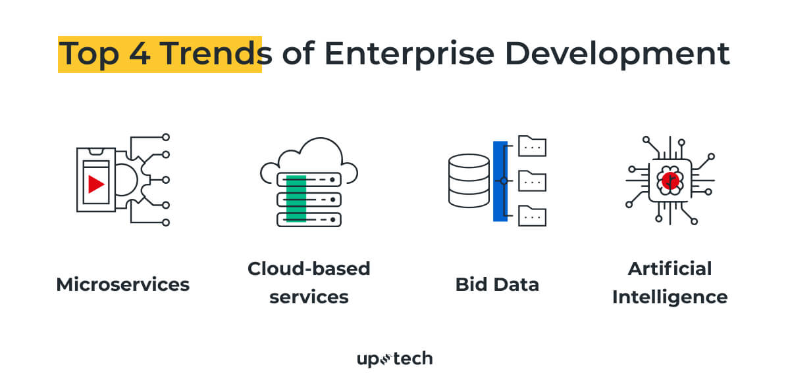
What Is Enterprise App Development?
Enterprise app development is the process of developing scalable apps that help companies facilitate their business processes. For example, an enterprise app helps to:
Keep company data updated across systems;
Align company divisions towards common goals;
Reduce handoff expenses between departments;
Help management to make data-informed decisions;
Have a centralized place to manage company processes.
Top 4 Trends Of Enterprise Development

Slide 5
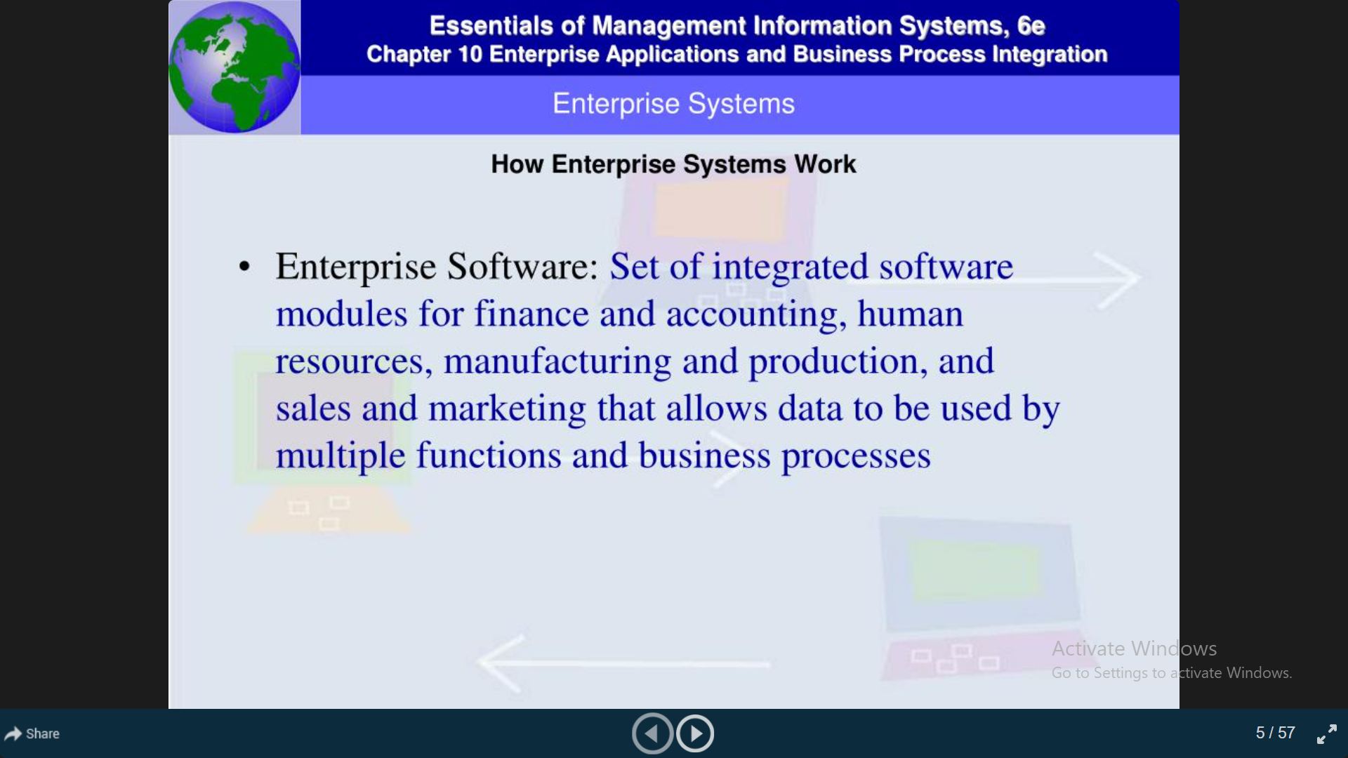
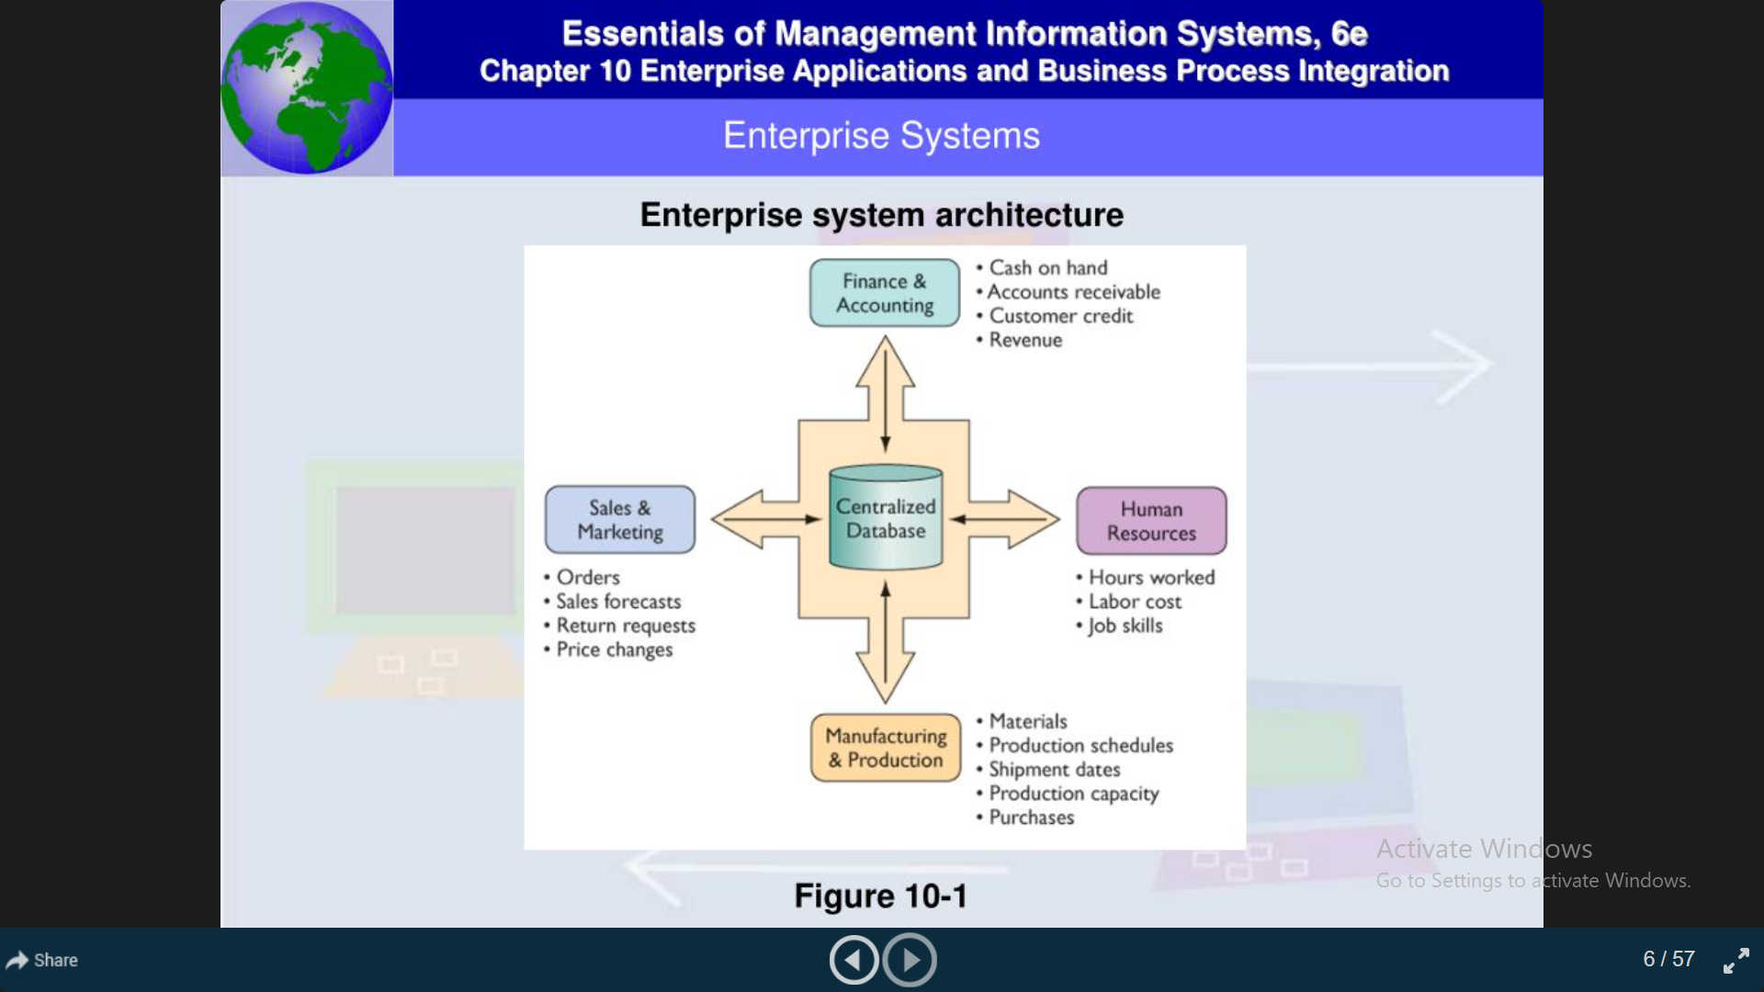
Enterprise Applications

Slide 6
Enterprise Application “Complex, Scalable, Distributed Component Based Mission Critical Business apps “
Properties of Enterprise Apps
Large Size
Lot of Users
Large Volume of Data handling
Long – Lived (Extended apps life)
Distributed
Deployed @Heterogeneous Environment
Team Development with Longer Duration
Mission Critical - Hard Attributes like Transaction and Security
System of System

Slide 7
Enabling - Enterprise App’s Requirements
Enterprise User Enabling – Desktop, Web and mobile
Enterprise Data Enabling – SQL Databases and NoSql Databases
Application Enabling – Past, Present and Future Apps - EAI
Communication Enabling – Synchronous and Asynchronous
Common Services
System Assurances - Qos

Slide 8
Challenges for Enterprise Apps
Handling The Complexity
Size – No. of Users, Apps, Clients and Data
Heterogeneity – Platforms, OS, Middleware and Vendors
Scalability
Number of Users
Number of Apps, Services
Elastic nature of Demands
Mission Critical – Hard Attributes
Availability – 365, 24 X7, Whenever as well as Wherever
Reliability – as in specifications, Predictable, RT Error and Fault Tolerance
Performance
Enterprise Organization
Ownership
Silos / Chaos
Integration and Interoerability
Distributed
System of System
Non-functional Requirements >>> Functional Requirements
High Longevity (Increased Life Time) – Staff Turnover, Technology Up gradation and Adaptability
Larger Team and Longer Development – Divison of Work, Incremental , Standards and Interoperability
High Qos
More Clients and High Responsiveness - Multi-Channel access with consistency
Usability

Slide 9
What is Enterprise?
Large organization such as multinational corporation, university, hospital, research laboratory, or government organization
Requires special computing solutions because of its size
Enterprise computing—use of computers in networks that encompass variety of operating systems, protocols, and network architectures

Slide 10
Enterprise
An Enterprise is a complex , Socio-technical and distributed system that comprises independent resources of People, Information, Cultural, Process and Technology components that must interact with each other and their environment in support of a common mission such as to Preserve , Grow and protect Enterprise’s base .
Enterprise Categories
Size : Small, Medium, Large
Profit : Commercial , Non Profit , Government
Domain : Manufacturing, Financial, Health and Education
Scope : Local, National , MNC
Lifetime : Startup, Legendary

Slide 11
Components of an Enterprise
Resources/ Assets
People/Users Partners
Employees/Contractors
Information
Customers
Knowledge

